Slide 1
Explanations in recommender systems

Slide 2
Explanations in recommender systems
Motivation
“The digital camera Profishot is a must-buy for you because . . . .”
Why should recommender systems deal with explanations at all?
The answer is related to the two parties providing and receiving recommendations:
A selling agent may be interested in promoting particular products
A buying agent is concerned about making the right buying decision

Slide 3
Types of explanations
(Brewer et al. 1998) distinguishes among
Functional,
"The car type Jumbo-Family-Van of brand Rising-Sun would be well suited to your family because you have four children and the car has seven seats"
Causal,
"The light bulb shines because you turned it on"
Intentional,
"I washed the dishes because my brother did it last time"
"You have to do your homework because your dad said so"
Scientific explanations
Express relations between the concepts formulated in various scientific fields and are typically based on refutable theories

Slide 4
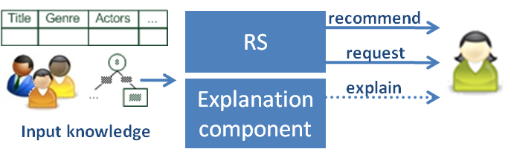
What is an explanation in recommender systems?
Additional information to explain the system’s output following some objectives

Slide 5
The goals for providing explanations (1) (Tintarev and Masthoff 2007)
Transparency
Provide information so the user can comprehend the reasoning used to generate a specific recommendation
Provide information as to why one item was preferred over another
Validity
Allow a user to check the validity of a recommendation
Not necessarily related to transparency
E.g., a neural network (NN) decides that product matches to requirements. Transparent disclosure of NN’s computations, will not help, but a comparison of required and offered product features allows customer to judge the recommendation’s quality.

Slide 6
The goals for providing explanations (2)
Trustworthiness
Trust building can be viewed as a mechanism for reducing the complexity of human decision making in uncertain situations
Reduce the uncertainty about the quality of a recommendation
Persuasiveness
Persuasive explanations for recommendations aim to change the user's buying behavior
E.g., a recommender may intentionally dwell on a product's positive aspects and keep quiet about various negative aspects
Effectiveness
The support a user receives for making high-quality decisions
Help the customer discover his or her preferences
Help users make better decisions

Slide 7
The goals for providing explanations (3)
Efficiency
Reduce the decision-making effort
Reduce the time needed for decision making
Another measure might also be the perceived cognitive effort
Satisfaction
Improve the overall satisfaction stemming from the use of a recommender system
Relevance
Additional information may be required in conversational recommenders
Explanations can be provided to justify why additional information is needed from the user

Slide 8
The goals for providing explanations (4)
Comprehensibility
Recommenders can never be sure about the knowledge of their users
Support the user by relating the user's known concepts to the concepts employed by the recommender
Education
Educate users to help them better understand the product domain
Deep knowledge about the domain helps customers rethink their preferences and evaluate the pros and cons of different solutions
Eventually, as customers become more informed, they are able to make wiser purchasing decisions
The aforementioned aims for generating explanations can be interrelated
Persuasiveness+ → Trust-
Effectiveness+ → Trust+
…

Slide 9
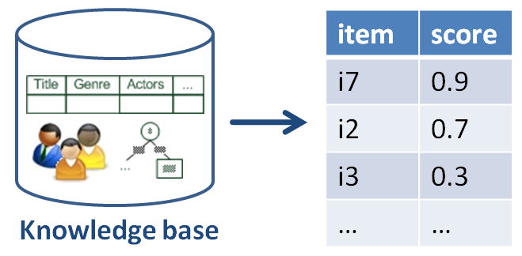

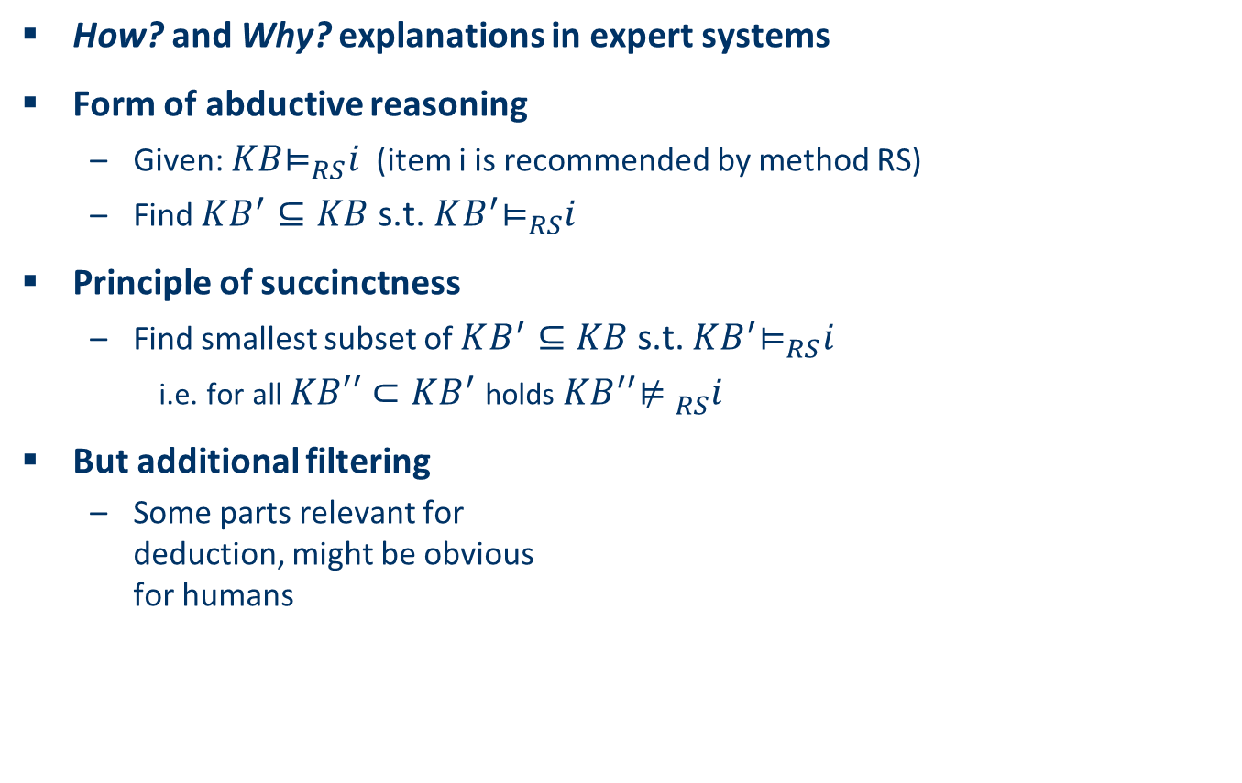
Explanations in general
How? and Why? explanations in expert systems
Form of abductive reasoning
Given: ${KB\text{⊨}}_{RS}i$ (item i is recommended by method RS)
Find $KB^{′}⊆KB$s.t. ${KB^{′}\text{⊨}}_{RS}i$
Principle of succinctness
Find smallest subset of $KB^{′}⊆KB$s.t. ${KB^{′}\text{⊨}}_{RS}i$
i.e. for all $KB′′⊂KB^{′}$holds${{ KB}^{′′}\text{⊭} }_{RS}i$
But additional filtering
Some parts relevant for deduction, might be obvious for humans
[Friedrich & Zanker, AI Magazine, 2011]

Slide 10
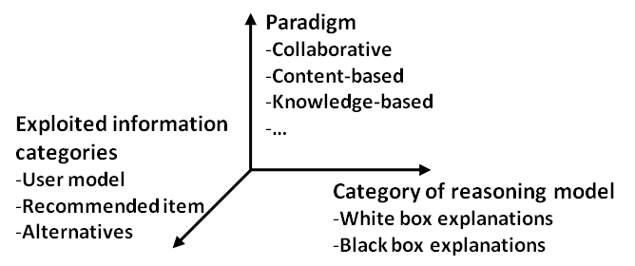
Taxonomy for generating explanations in RS
Major design dimensions of current explanation components:
Category of reasoning model for generating explanations
White box
Black box
RS paradigm for generating explanations
Determines the exploitable semantic relations
Information categories

Slide 11
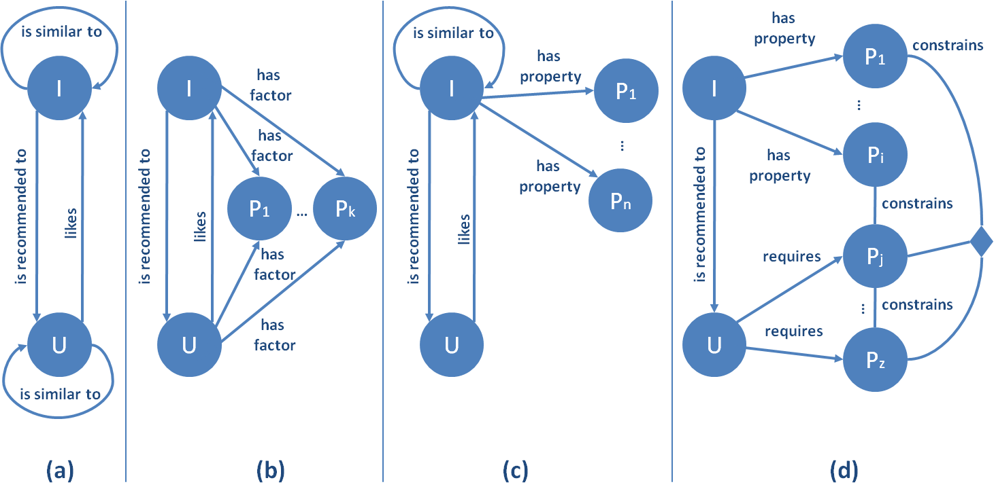
Archetypes of KB
Classes of objects
Users
Items
Properties
N-ary relations between them
Collaborative filtering
Neighborhood based CF (a)
Matrix factorization (b)
Introduces additional factors as proxies for determining similarities

Slide 12
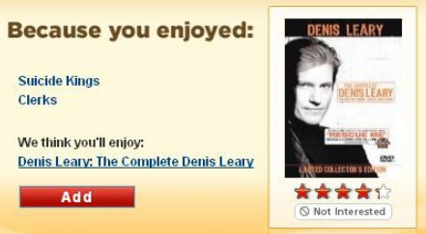
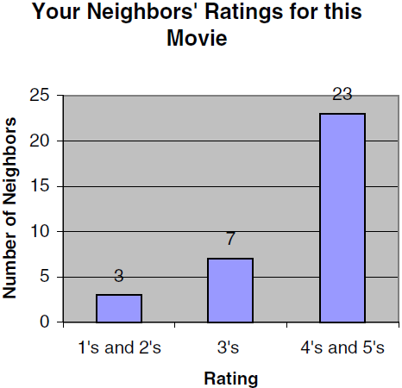
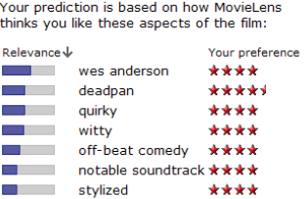
Examples
Similarity between items
Similarity between users
Tags
Tag relevance (for item)
Tag preference (of user)

Slide 13
Explanations in collaborative filtering recommenders
Explicit recommendation knowledge is not available
Recommendations based on CF cannot provide arguments as to why a product is appropriate for a customer or why a product does not meet a customer's requirements
The basic idea of CF is to mimic the human word-of-mouth recommendation process
Therefore, give a comprehensible account of how this word-of-mouth approach works:
Customers rate products
The CF locates customers with similar ratings (i.e., tastes), called neighbors
Products that are not rated by a customer are rated by combining the ratings of the customer’s neighbors

Slide 14
Evaluating explanation interfaces (Herlocker et al. 2000)
Herlocker et al. (2000) examined various implementations of explanation interfaces in the domain of the "MovieLens" system
Twenty-one variants were evaluated
Customers were asked, on a scale of 1 to 7, how likely they would be to go to see a recommended movie after a recommendation for this movie was presented and explained by one of the twenty-one different explanation approaches
They also included the base case in which no additional explanation data were presented
In addition to the base case, an explanation interface was designed that just output the past performance of the recommendation system – for instance,
"MovieLens has provided accurate predictions for you 80% of the time in the past"

Slide 15
The results of the study by Herlocker et al. (2000)
The best-performing explanation interfaces are based on the ratings of neighbors
In these cases similar neighbors liked the recommended film, and this was comprehensibly presented. The histogram performed better than the table

Slide 16
The results of the study by Herlocker et al. (2000)
Recommenders using the simple statement about the past performance of MovieLens were the second best performer
Content-related arguments mentioning the similarity to other highly rated films or a favorite actor or actress were among the best performers
Poorly designed explanation interfaces decreased the willingness of customers to follow the recommendation, even compared with the base case
Too much information has negative effects; poor performance was achieved by enriching the data presented in histograms with information about the proximity of neighbors
Interestingly, supporting recommendations with ratings from domain authorities, such as movie critics, did not increase acceptance

Slide 17
Tagsplanations (Vig et al. 2010)
Tag relevance (for item)
X .. Set of (mean-adjusted) ratings for I among users of tag t (U_{ti})
Y .. Inferred tag preferences
Correlation between user’s preference for the tag and their preference for the item

Slide 18
Tagsplanations (Vig et al. 2010)
Tag preference (of user)
I_{u} .. Items rated by u
k .. Smoothing constant, the smoothing constant k accounts for users who have rated few items with a given tag. This smoothing serves to bring the computed tag preference closer to the user’s average rating, because ratings of a small number of items may not properly reflect a user’s tag preference
tag_share(t,i) ..The tag_share of a tag t applied to an item i is the number of times t has been applied to i, divided by the number of times any tag has been applied to i
Relative importance of tag t for items the user knows and likes compared to the relative importance of t for the known items

Slide 19
Archetypes of KB
Content-based
Properties characterizing items
TF*IDF model
Knowledge based
Properties of items
Properties of user model
Additional mediating domain concepts

Slide 20
Explanations in case-based recommenders
The generation of solutions in case-based recommenders is realized by identifying the products that best fit a customer's query
Each item of a product database corresponds to a case
Customer query puts constraints on the attributes of products
For example, a customer is interested only in digital cameras that cost less than a certain amount of money

Slide 21
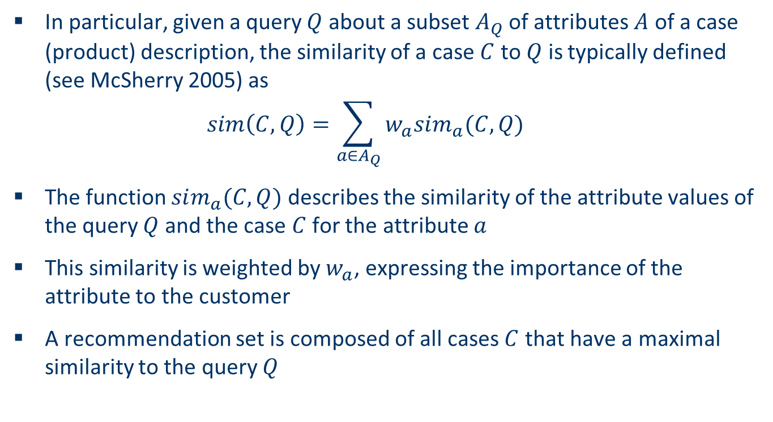
Explanations in case-based recommenders
In particular, given a query $Q$ about a subset $A_{Q}$ of attributes $A$ of a case (product) description, the similarity of a case $C$ to $Q$ is typically defined (see McSherry 2005) as
$$sim\left(C,Q\right)=\sum_{a∈A_{Q}}{w_{a}sim_{a}(C,Q)}$$
The function $sim_{a}(C,Q)$ describes the similarity of the attribute values of the query $Q$ and the case $C$ for the attribute $a$
This similarity is weighted by $w_{a}$, expressing the importance of the attribute to the customer
A recommendation set is composed of all cases $C$ that have a maximal similarity to the query $Q$

Slide 22
Explaining solutions (1)
The typical approach used to answer a why-question is to compare the presented case with the customer requirements and to highlight which constraints are fulfilled and which are not (McSherry 2003b)
Example:
id | price | mpix | Opt-zoom | LCD-size | movies | sound | waterproof
p1 | 148 | 8.0 | 4x | 2.5 | no | no | yes
p2 | 182 | 8.0 | 5x | 2.7 | yes | yes | no
p3 | 189 | 8.0 | 10x | 2.5 | yes | yes | no
p4 | 196 | 10.0 | 12x | 2.7 | yes | no | yes
p5 | 151 | 7.1 | 3x | 3.0 | yes | yes | no
p6 | 199 | 9.0 | 3x | 3.0 | yes | yes | no
p7 | 259 | 10.0 | 3x | 3.0 | yes | yes | no
p8 | 278 | 9.1 | 10x | 3.0 | yes | yes | yes

Slide 23
Explaining solutions (2)
If a customer is interested in digital cameras with a price less than 150, then p1 is recommended.
id | price | mpix | Opt-zoom | LCD-size | movies | sound | waterproof
p1 | 148 | 8.0 | 4x | 2.5 | no | no | yes
p2 | 182 | 8.0 | 5x | 2.7 | yes | yes | no
p3 | 189 | 8.0 | 10x | 2.5 | yes | yes | no
p4 | 196 | 10.0 | 12x | 2.7 | yes | no | yes
p5 | 151 | 7.1 | 3x | 3.0 | yes | yes | no
p6 | 199 | 9.0 | 3x | 3.0 | yes | yes | no
p7 | 259 | 10.0 | 3x | 3.0 | yes | yes | no
p8 | 278 | 9.1 | 10x | 3.0 | yes | yes | yes
Why?

Slide 24
Explaining solutions (3)
The weights of the attributes can be incorporated into the answers
If the customer requires a price less than 160 and LCD size of more than 2.4 inches, where LCD size is weighted much more than price, then p5 is recommended
id | price | mpix | Opt-zoom | LCD-size | movies | sound | waterproof
p1 | 148 | 8.0 | 4x | 2.5 | no | no | yes
p2 | 182 | 8.0 | 5x | 2.7 | yes | yes | no
p3 | 189 | 8.0 | 10x | 2.5 | yes | yes | no
p4 | 196 | 10.0 | 12x | 2.7 | yes | no | yes
p5 | 151 | 7.1 | 3x | 3.0 | yes | yes | no
p6 | 199 | 9.0 | 3x | 3.0 | yes | yes | no
p7 | 259 | 10.0 | 3x | 3.0 | yes | yes | no
p8 | 278 | 9.1 | 10x | 3.0 | yes | yes | yes
Why?

Slide 25
Explaining solutions (4)
The requirements of a customer might be too specific
Why-explanations provide information about the violated constraints
For example, if the customer requires a price less than 150 and a movie function, then no product fulfills these requirements.
id | price | mpix | Opt-zoom | LCD-size | movies | sound | waterproof
p1 | 148 | 8.0 | 4x | 2.5 | no | no | yes
p2 | 182 | 8.0 | 5x | 2.7 | yes | yes | no
p3 | 189 | 8.0 | 10x | 2.5 | yes | yes | no
p4 | 196 | 10.0 | 12x | 2.7 | yes | no | yes
p5 | 151 | 7.1 | 3x | 3.0 | yes | yes | no
p6 | 199 | 9.0 | 3x | 3.0 | yes | yes | no
p7 | 259 | 10.0 | 3x | 3.0 | yes | yes | no
p8 | 278 | 9.1 | 10x | 3.0 | yes | yes | yes
Most similar
products

Slide 26
Explaining solutions (5)
p1 and p5 can be considered as most similar products for a given similarity function, although one of the user requirements is not satisfied
A why-explanation for p1 would be,
"p1 is within your price range but does not include your movie requirement."
Techniques can be used to generate minimal sets of customer requirements that explain why no products fit,
Employed to propose minimal changes to the set of requirements such that matching products exist

Slide 27
Explanations in constraint-based recommenders
Answering two typical questions a customer is likely to pose (Buchanan and Shortliffe 1984)
Why-explanations
In the case that the recommendation process requires input from the customer, the customer could ask why this information is needed
How-explanations
When a recommender proposes a set of solutions (e.g., products) then a customer might ask for an explanation why a proposed solution would be advantageous for him or her
Next we examine methods for answering these two types of questions by exploiting the reasoning methods of constraint-based systems

Slide 28
An example from the car domain (1)
Two different packages are available for a car
Business package
Recreation package
The customer expresses requirements based on functions: easy parking, towing and hands-free mobile communication
The customer can decide if he or she wants one, both, or neither of these packages
Recreation package
Includes a coupling device for towing trailers and a video camera on the rear of the car, which allows the driver to ascertain the distance to an obstacle behind the car
This camera supports the customer oriented product function easy parking

Slide 29
An example from the car domain (2)
Business package
Includes a radio with a GSM telephone (GSM radio), which supports hands-free mobile communication
Includes a sensor system in the back bumper, which also supports easy parking
However, the sensor system is incompatible with the recreation package for technical reasons
From the customer's point of view, the video camera and the sensor system provide the same functionality. Therefore, if the customer orders the business package and the recreation package, the car includes the video camera, which implements the easy parking function
In this configuration, the sensors are not only forbidden (because they are incompatible with the coupling device), but also dispensable

Slide 30
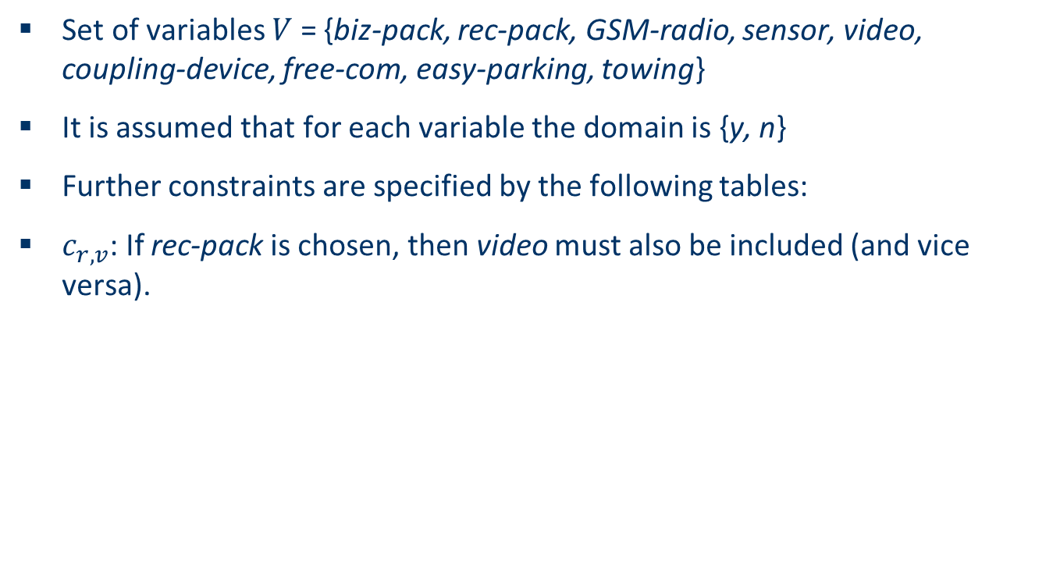
Model domain as a constraint satisfaction problem (1)
Set of variables $V$ = {biz-pack, rec-pack, GSM-radio, sensor, video, coupling-device, free-com, easy-parking, towing}
It is assumed that for each variable the domain is {y, n}
Further constraints are specified by the following tables:
$c_{r,v}$: If rec-pack is chosen, then video must also be included (and vice versa).
rec-pack | video
y | y
n | n

Slide 31

Model domain as a constraint satisfaction problem (2)
$c_{b,r,s}$: If biz-pack is chosen and rec-pack is not chosen, then sensor is included. rec-pack and sensor are incompatible:
biz-pack | rec-pack | sensor
y | y | n
y | n | y
n | y | n
n | n | n
n | n | y

Slide 32

Model domain as a constraint satisfaction problem (3)
$c_{v,s,e}$: If video or sensor is included, then easy-parking is supported (and vice versa)
video | sensor | easy-parking
n | n | n
y | n | y
n | y | y
y | y | y

Slide 33
Constraint network of car example

Slide 34
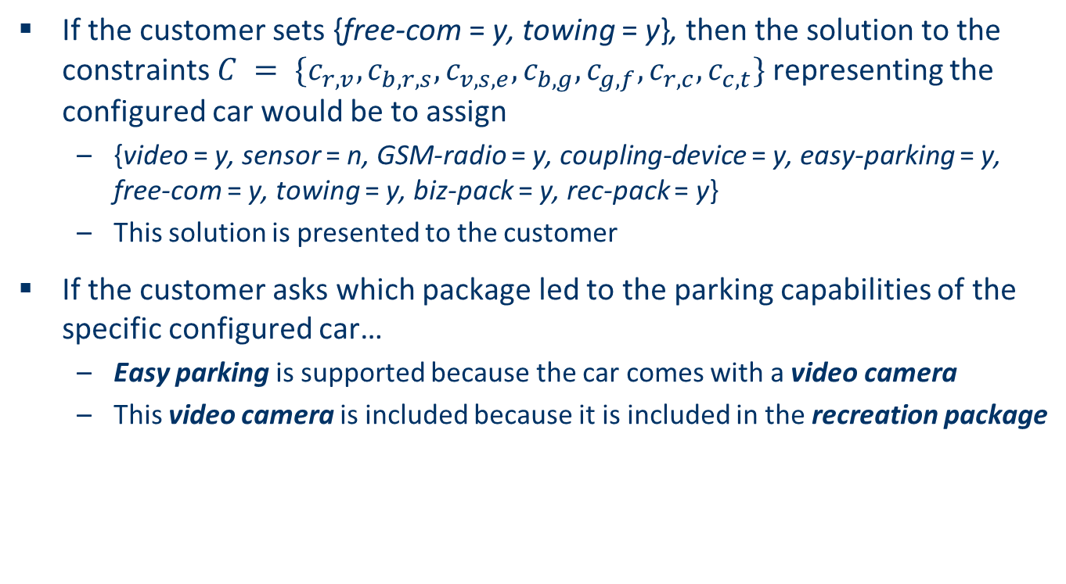
Explaining solutions
If the customer sets {free-com = y, towing = y}, then the solution to the constraints $C = \{c_{r,v}, c_{b,r,s}, c_{v,s,e}, c_{b,g}, c_{g,f}, c_{r,c}, c_{c,t}\}$ representing the configured car would be to assign
{video = y, sensor = n, GSM-radio = y, coupling-device = y, easy-parking = y, free-com = y, towing = y, biz-pack = y, rec-pack = y}
This solution is presented to the customer
If the customer asks which package led to the parking capabilities of the specific configured car…
Easy parking is supported because the car comes with a video camera
This video camera is included because it is included in the recreation package

Slide 35
User input and solution
Customer
input
Configuration (Part of CSP solution)
Functions
GSM-radio
C_{g,f}
free-com
biz-pack = y
C_{b,g}
{y, n}
{y,n }
biz-pack
YES
YES
{y, n}
y
y
C_{b,r,s}
sensor
n
{y, n}
n
NO
C_{v,s,e}
easy-parking
y
{y, n}
rec-pack
C_{r,v}
video
{y, n}
{y, n}
YES
rec-pack = y
YES

Slide 36
Why easy-parking? Some basics:
Constraint satisfaction Problem (CSP) defined by: C (Constraints), V (Variables), D (Domain)
Let (C,V,D) be a consistent CSP, Φ a constraint:
A subset C of C is called an explanation for Φ iff C ⊨ Φ. (Φ is true in all models of C.)
C is a minimal explanation for Φ iff no proper subset of C is an explanation for Φ.

Slide 37
Why easy-parking?
Customer
input
Configuration (Part of CSP solution)
Functions
easy-parking = y
C_{v,s,e}
easy-parking
{y, n}
rec-pack
C_{r,v}
video
YES
{y, n}
{y, n}
rec-pack = y
YES
Because rec-pack = y

Slide 38
Why easy-parking?
actual car
biz-pack = y
biz-pack
{y, n}
NO
y
y
YES
C_{b,r,s}
sensor
easy-parking = y
n
{y, n}
n
C_{v,s,e}
easy-parking
y
{y, n}
rec-pack
C_{r,v}
video
{y, n}
{y, n}
YES
YES
YES
YES
NO
NO
WORLD 1
consistent with presented solution
WORLD 2
NOT consistent with presented solution
Because biz-pack = y, in world 1 and 2 easy-parking = y, but world 2 does not correspond to original solution

Slide 39
Principal idea
Let (C,V,D) be a consistent CSP, Φ a constraint:
S: a specific solution (presented to the user).
A subset C of C is called an “explanation” for Φ iff C ⊨ Φ
and
the solutions s of C are consistent with S (i.e. agree on the value assignment) with respect to the relevant variables.
Details see (G. Friedrich 2004)

Slide 40

Application case for KB recommendation and explanation

Slide 41
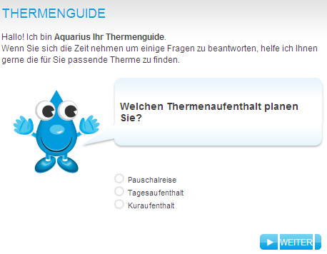
Thermencheck.com (hot spring resorts)

Slide 42
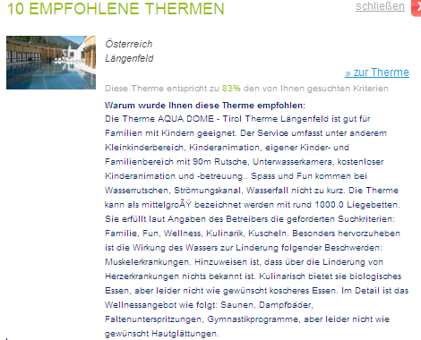
Recommendation

Slide 43
Explanation
It offers services for families with small children, such as X, Y and Z.
It is a spa resort of medium size offering around 1000 beds.
The water has favorable properties for X, but it is unknown if it also cures Y.
It offers organic food, but no kosher food.

Slide 44
Results from testing the explanation feature
+**
Positive
Usage exp.
Perceived
Utility
+**
+*
Recommend others
+**
Explanation
+
Intention to repeated usage
+**
Trust
** sign. < 1%, * sign. < 5%
Knowledgeable explanations significantly increase the users’ perceived utility
Perceived utility strongly correlates with usage intention etc.

Slide 45
Explanations in recommender systems: Summary
There are many types of explanations and various goals that an explanation can achieve
Which type of explanation can be generated depends greatly on the recommender approach applied
Explanations may be used to shape the wishes and desires of customers but are a double-edged sword
On the one hand, explanations can help the customer to make wise buying decisions;
On the other hand, explanations can be abused to push a customer in a direction which is advantageous solely for the seller
As a result a deep understanding of explanations and their effects on customers is of great interest.

Slide 46
Literature
[Brewer et al. 1998] Explanation in scientists and children, Minds and Machines 8 (1998), no. 1, 119–136
[Buchanan and Shortliffe 1984] Rule-based expert systems: The Mycin experiments of the Stanford Heuristic Programming Project (the Addison-Wesley series in artificial intelligence), Addison-Wesley Longman, Boston, 1984
[G. Friedrich 2004] Elimination of spurious explanations, Proceedings of the 16th European Conference on Artificial Intelligence, IOS Press, 2004.
[Herlocker et al. 2000] Explaining collaborative filtering recommendations, Proceedings of the 2000 ACM Conference on Computer Supported Cooperative Work (CSCW ’00) (Philadelphia), ACM, 2000, pp. 241–250
[Friedrich and Zanker 2011] A Taxonomy for Generating Explanations in Recommender Systems, AI Magazine, Vol 32(3), 2011.
[McSherry 2003b] Similarity and compromise, Proceedings of the 5th International Conference on Case-Based Reasoning (ICCBR ’03) (Trondheim, Norway) (Kevin D. Ashley and Derek G. Bridge, eds.), LNCS, vol. 2689, Springer, June 2003b, pp. 291–305
[McSherry 2005] Explanation in recommender systems,Artificial Intelligence Review24 (2005), no. 2, 179–197
[Tintarev 2007] Explanations of recommendations, Proceedings of the 2007 ACM Conference on Recommender Systems (RecSys ’07) (Minneapolis, MN), ACM, 2007, pp. 203–206
[Tintarev and Masthoff 2007] Effective explanations of recommendations: user-centered design, Proceedings of the 2007 ACM Conference on Recommender Systems (RecSys’07) (Minneapolis, MN), ACM, 2007, pp. 153–156
[Vig et al., 2009] Tagsplanations: Explaining Recommendations Using Tags, In IUI '09: Proceedings of the 13th international conference on Intelligent user interfaces (IUI’09) , pp. 47–56

